Slide 1
Ciencia de los materiales
Tipos de metales
Ángel Villarreal Pérez
1803136
Grupo:013
Salon:1305

Slide 2
metals
Metals are called the chemical elements characterized by being good conductors of heat and electricity. They have high density and are solid at room temperature (except mercury); its salts form electropositive ions (cations) in solution.
Dentro de los metales se encuentran los alcalinos (como el sodio) y los alcalinotérreos (como el magnesio) los cuales presentan baja densidad, son buenos conductores del calor y la electricidad, además de ser muy reactivos. También se incluyen los metales de transición (los cuales conforman la mayoría de los metales), los que se encuentran en diversos grupos y los lantánidos, actínidos y transactínidos. Teóricamente, el resto de elementos que queda por descubrir y sintetizar serían metales.

Slide 3
Property of metals
Metals have characteristic physical properties, including they are conductors of electricity. Most of them are grayish in color, but some have different colors; bismuth (Bi) is pinkish, copper (Cu) reddish and gold (Au) yellow. In other metals, more than one color appears; This phenomenon is called polychromism.
Other properties would be:
Malleability: the ability of metals to become sheets when subjected to compression efforts.
Ductility: property of the metals to be molded into wire and threads when subjected to tensile stresses.
Tenacity: resistance that the metals present when breaking or when receiving abrupt forces (blows, etc.)
Mechanical resistance: ability to withstand tensile stress, compression, torsion and bending without deforming or breaking.
They are usually opaque or of metallic shine, have high density, are ductile and malleable, have a high melting point, are hard, and are good conductors (heat and electricity).

Slide 4
history of metals
Metals such as gold, silver and copper were used since prehistory. At the beginning, only those that were easily in their pure state (in the form of native elements) were used, but gradually the necessary technology was developed to obtain new metals from their ores, heating them in a furnace using wood charcoal.
The first great advance was made with the discovery of bronze, the result of the use of copper ore with tin incursions, between 3500 a. C. and 2000 a. C., in different regions of the planet, emerging the so-called Bronze Age, which happens to the Stone Age.
Another important fact in history was the use of iron, around 1400 BC. C. The Hittites were one of the first peoples to use it to make weapons, such as swords, and civilizations that were still in the Bronze Age, such as the Egyptians
However, in ancient times it was not known to reach the temperature necessary to melt the iron, so that an impure metal was obtained that had to be hammered. Towards the year 1400 began to use the furnaces provided with bellows, 7 that allow to reach the melting temperature of iron, about 1535 ° C.
Henry Bessemer discovered a way to produce steel in large quantities at a reasonable cost. After numerous failed attempts, he came up with a new furnace design (the Thomas-Bessemer converter) and, thereafter, improved the construction of structures in buildings and bridges, passing the iron to a second plane.
Aluminum and magnesium were used shortly afterwards, which made it possible to develop much lighter and more resistant alloys, widely used in aviation, land transport and portable tools.
Titanium is the last of the abundant and stable metals with which we are working and it is expected that, in a short time, the use of titanium technology will become widespread.

Slide 5
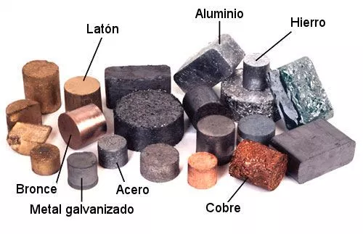
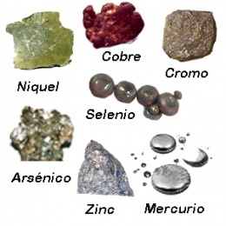
Types of metals

Slide 6
referencias
Diccionario de química. Editorial Complutense. 2003. ISBN 9788489784727. Consultado el 2 de febrero de 2018.
Rivera, José María Teijón; Teijón, José María (2006). La química en problemas. Editorial Tebar. ISBN 9788473602266. Consultado el 2 de febrero de 2018.
Gillespie, Ronald J. (agosto de 1988). Química. Reverte. ISBN 9788429171884. Consultado el 2 de febrero de 2018.
Principios de Quimica. Reverte. Consultado el 2 de febrero de 2018.
Daub, G. William; Seese, William S. (1996). Química. Pearson Educación. ISBN 9789688807903. Consultado el 2 de febrero de 2018.
Científicas, SINC Servicio de Información y Noticias (23 de marzo de 2015). IZw18, la galaxia que revela el pasado del universo. Consultado el 2 de febrero de 2018.

